Slide 1


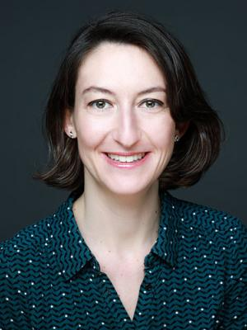
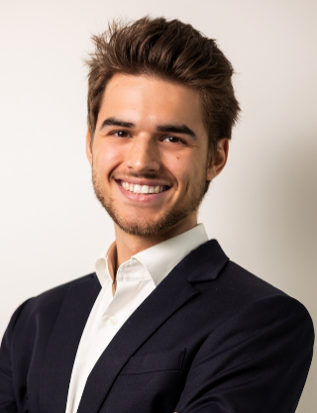
Transatlantic Research & Career Opportunities
Alice Bernard-Tessier, MD
PI
Gustave Roussy
Balthazar Le Meur, PharmD
Strategic Partnerships
Gustave Roussy
Join us for an informal discussion introducing Gustave Roussy and exploring academic careers and research at Europe’s leading cancer center
17th April | 12pm-1pm
Building E19, room 202
Lunch will be provided

