Slide 1
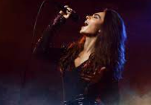
PDA
Friday Karaoke Night
When: Friday night 5:30 pm-8:00 pm, Starting Nov. 12th, 2021
Where: Station Bistro & KTV at Boston Downtown
Transport: Meet at Kendall/MIT redline station at 5:30 pm, or meet at the KTV at 6 pm.
Cost: Free for a limited first come first serve basis
Join us now: https://forms.gle/UQpHahpNHf71fQU16

