Slide 1
Use of Mobile Device to Facilitate Cervical Cancer Screening in Zambia
Andres Monroy-Hernandez
Leo Anthony Celi
Advisers: Daniel Myung, Gari Clifford

Slide 2
Outline
The Problem and Background
Current Landscape
ICT Solution
Metrics
Assessing Value and Sustainability
Future Directions

Slide 3
The Problem and Background
Cervical cancer is leading cause of cancer death among women in poor countries
Annual pap smear proven effective for prevention done in developed countries not possible due to resource constraints
Visual inspection (VIA) a good alternative but quality assurance requires specialist input

Slide 4
Current Landscape
VIA with a low threshold for cryotherapy: high false-positive rate
False-positives require follow-up and unnecessarily consume an already-constrained health care manpower
Impossible to scale unless real-time specialist support can be provided to minimize false-positives

Slide 5
ICT Solution
Cell phones to facilitate both real-time and store-and-forward medical consultation already established tool for delivering specialty care
Agreement rate between face-to-face medical encounters and tele-clinicians can approach almost 95% (Whited et al., 2004)

Slide 6
ICT Solution
Goal is to develop an application that
  captures image
  resizes and transmits image to both a server and an off-site specialist

Slide 7
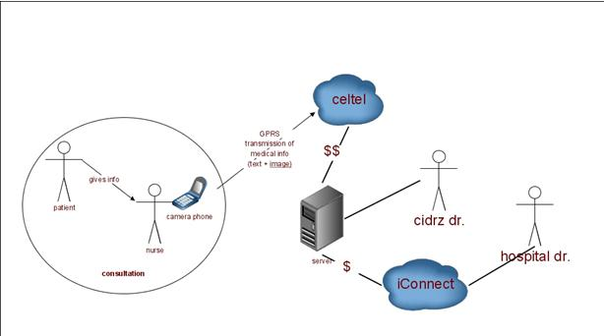
Use Case Diagram

Slide 8
Server-End
Information Management
Why can’t we just transmit directly to a specialist?
Archival and information management in a server
  Allow longitudinal care
  Quality assurance/Quality improvement
  Data mining

Slide 9
Web Interface

Slide 10
Demonstration

Slide 11
Addressing Privacy Issue
Patients assigned a unique identifier
Assignment only available at health center database
Patient ID transmitted with image and clinical information
Only patient ID stored in cell phone and server
Patients referred to Lusaka will be accompanied by a letter with their patient ID number

Slide 12
Quality Assurance
Quality Improvement
Process Metrics
Outcome Metrics
No. of images that did not go through
No. of suboptimal images requiring re-taking or re-sending
Response time of on-call doctor
No. of images sent per week needing specialist input
No. of misdiagnosis after regular QA/QI review
Before and after roll-out of ICT solution:
Incidence of cervical cancer
Death rate from cervical cancer

Slide 13
Insuring Sustainability
Demonstrating value is key in order to insure sustainability
Even more important for ICT4D projects given limited resources
Notes:
The use of expensive technology should be justified by value, not by its ingenious design and demonstration of its feasibility. It has to facilitate the most cost-effective way of achieving the desired outcomes and the delivery of the best return-on-investment.

Slide 14
Insuring Sustainability
Cost-effectiveness analysis
  Outcomes tracking (How many cervical cancers are prevented? How many lives saved?)
  Cost information (labor, ICT)
  Calculation of cost per year of life saved
These analyses can provide guidance for the global community by identifying health investments that are of the highest priority and are most cost-efficient.

