Slide 1
Use of Mobile Device to Facilitate Cervical Cancer Screening in Zambia
Andres Monroy-Hernandez
Leo Anthony Celi

Slide 2
Needs Assessment
Telephone conference with doctors from Center for Infectious Disease Research In Zambia (CIDRZ)
  Granularization of user requirements
  Workflow re-design
  Implementation planning (i.e. pilot -> roll-out)

Slide 3
Needs Assessment
Survey of GPRS and internet service providers in Zambia
  Connectivity
  Cost
Risk assessment
  Operational/technical
  Financial
  Organizational

Slide 4
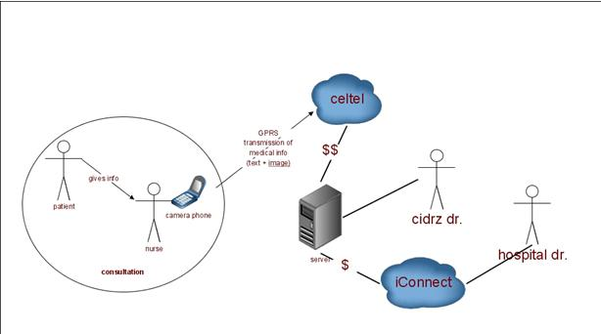
Use Case Diagram

Slide 5
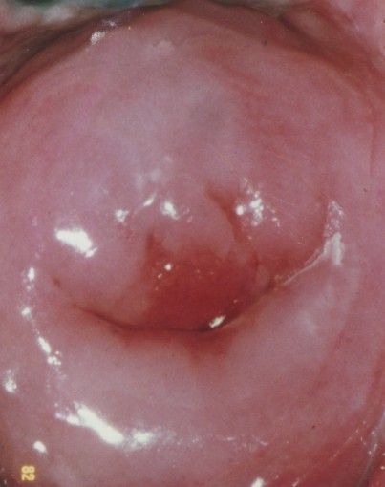
Client-End Application
Date and time stamp
Patient ID
Clinic
Practitioner ID
Age
Year of last screening
HIV status
ARV status
CD4 count
GYN history
  Previous cervical lesion
  Previous treatment

Slide 6
Demonstration

Slide 7
Addressing Privacy Issue
Patients assigned a unique identifier
Assignment only available at health center database
Patient ID transmitted with image and clinical information
Only patient ID stored in cell phone and server
Patients referred to Lusaka will be accompanied by a letter with their patient ID number

Slide 8
Quality Assurance
Quality Improvement
Process Metrics
Outcome Metrics
No. of images that did not go through
No. of suboptimal images requiring re-taking or re-sending
Response time of on-call doctor
No. of images sent per week needing specialist input
No. of misdiagnosis after regular QA/QI review

Slide 9
Insuring Sustainability
Demonstrating value is key in order to insure sustainability
Even more important for ICT4D projects given limited resources
Notes:
The use of expensive technology should be justified by value, not by its ingenious design and demonstration of its feasibility. It has to facilitate the most cost-effective way of achieving the desired outcomes and the delivery of the best return-on-investment.

Slide 10
Insuring Sustainability
Cost-effectiveness analysis using mathematical modeling
  Meticulous tracking of outcome metrics
  Cost information including additional cost of technology
  Calculation of cost per year of life saved
  Compare against per capita GDP
These analyses can provide guidance for the global community by identifying health investments that are of the highest priority and are most cost-efficient.

Slide 11
Next Step
Server-End Application using LAMP
Web interface

