Slide 1
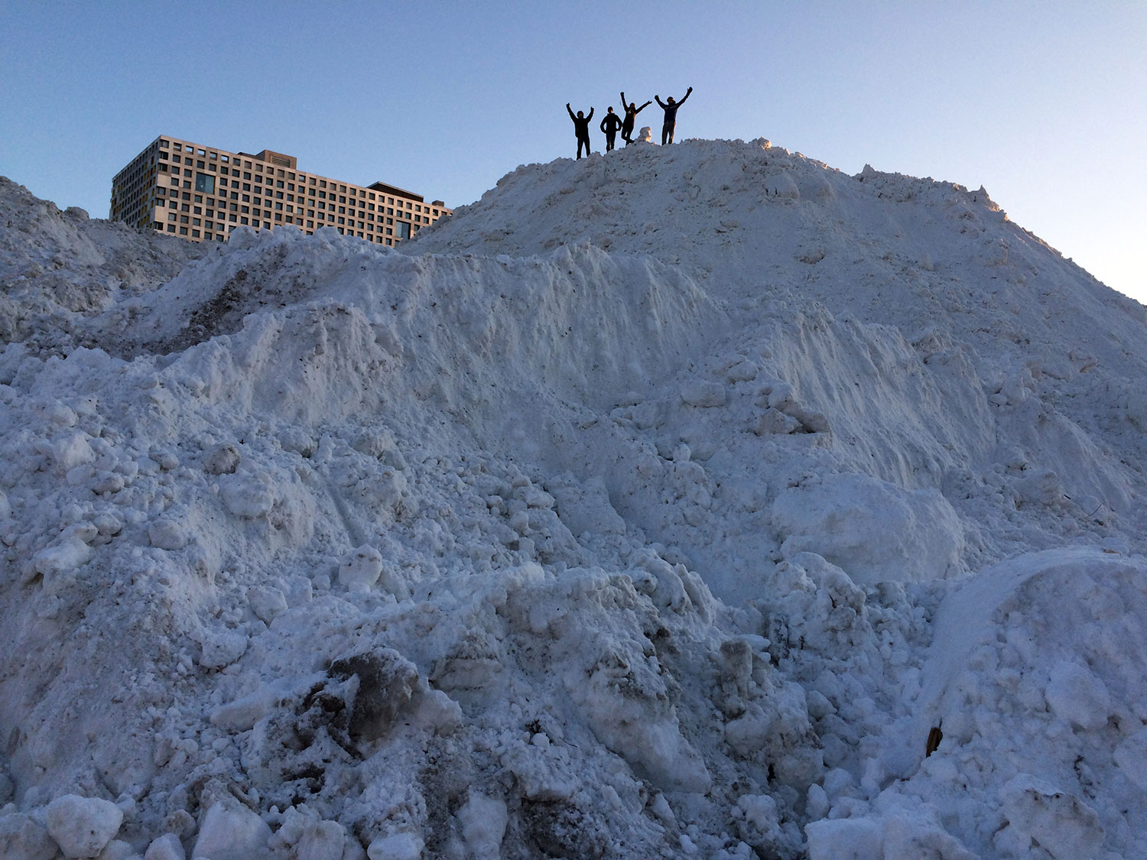
Managing with
Omicron
IAP 2022
January 5, 2022
Note: This snow mountain eventually melted.

Slide 2
Agenda
Welcome & Overview
Campus Covid Updates with Suzanne Blake, Ian A. Waitz, Cecilia Stuopis, & Shawn Ferullo
Context; case updates; new CDC guidance; changes to protocols/messages
DSL updates with Suzy Nelson, David Randall, Kate McCarthy, Judy Robinson, David Friedrich,
& Mark Hayes
Isolation support; house management; food service; and other topics
Q & A
Notes:
Welcome & overview (Suzy)
Covid updates (Suzanne, Ian, Cecilia & Shawn)
Overall context
MIT case update / Dashboard update
What new CDC guidance on isolating means for MIT
Changes to automated messages
Sample messages received when entering and clearing isolation
Clarification on “Quiet period”
DSL updates
Isolation support (David Randall, Kate & Judy)
House notifications
Support services
Roommates (e.g., antigen tests management tool)
Grads
GRA & AD role
House management (David Friedrich)
Bathroom use
Food service (Mark)
No food/drink at campus events; grab & go ok for small house events
Isolation food pick-up locations
Other
Q & A

Slide 3
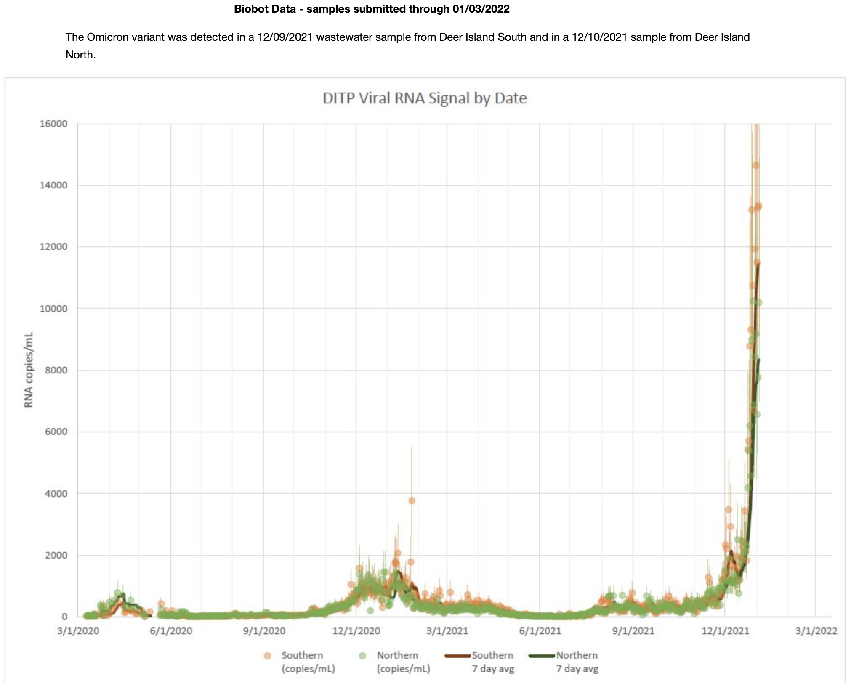
Viral loads in the greater Boston area
~10x higher than any time in the prior two years of the pandemic
https://www.mwra.com/biobot/biobotdata.htm

Slide 4
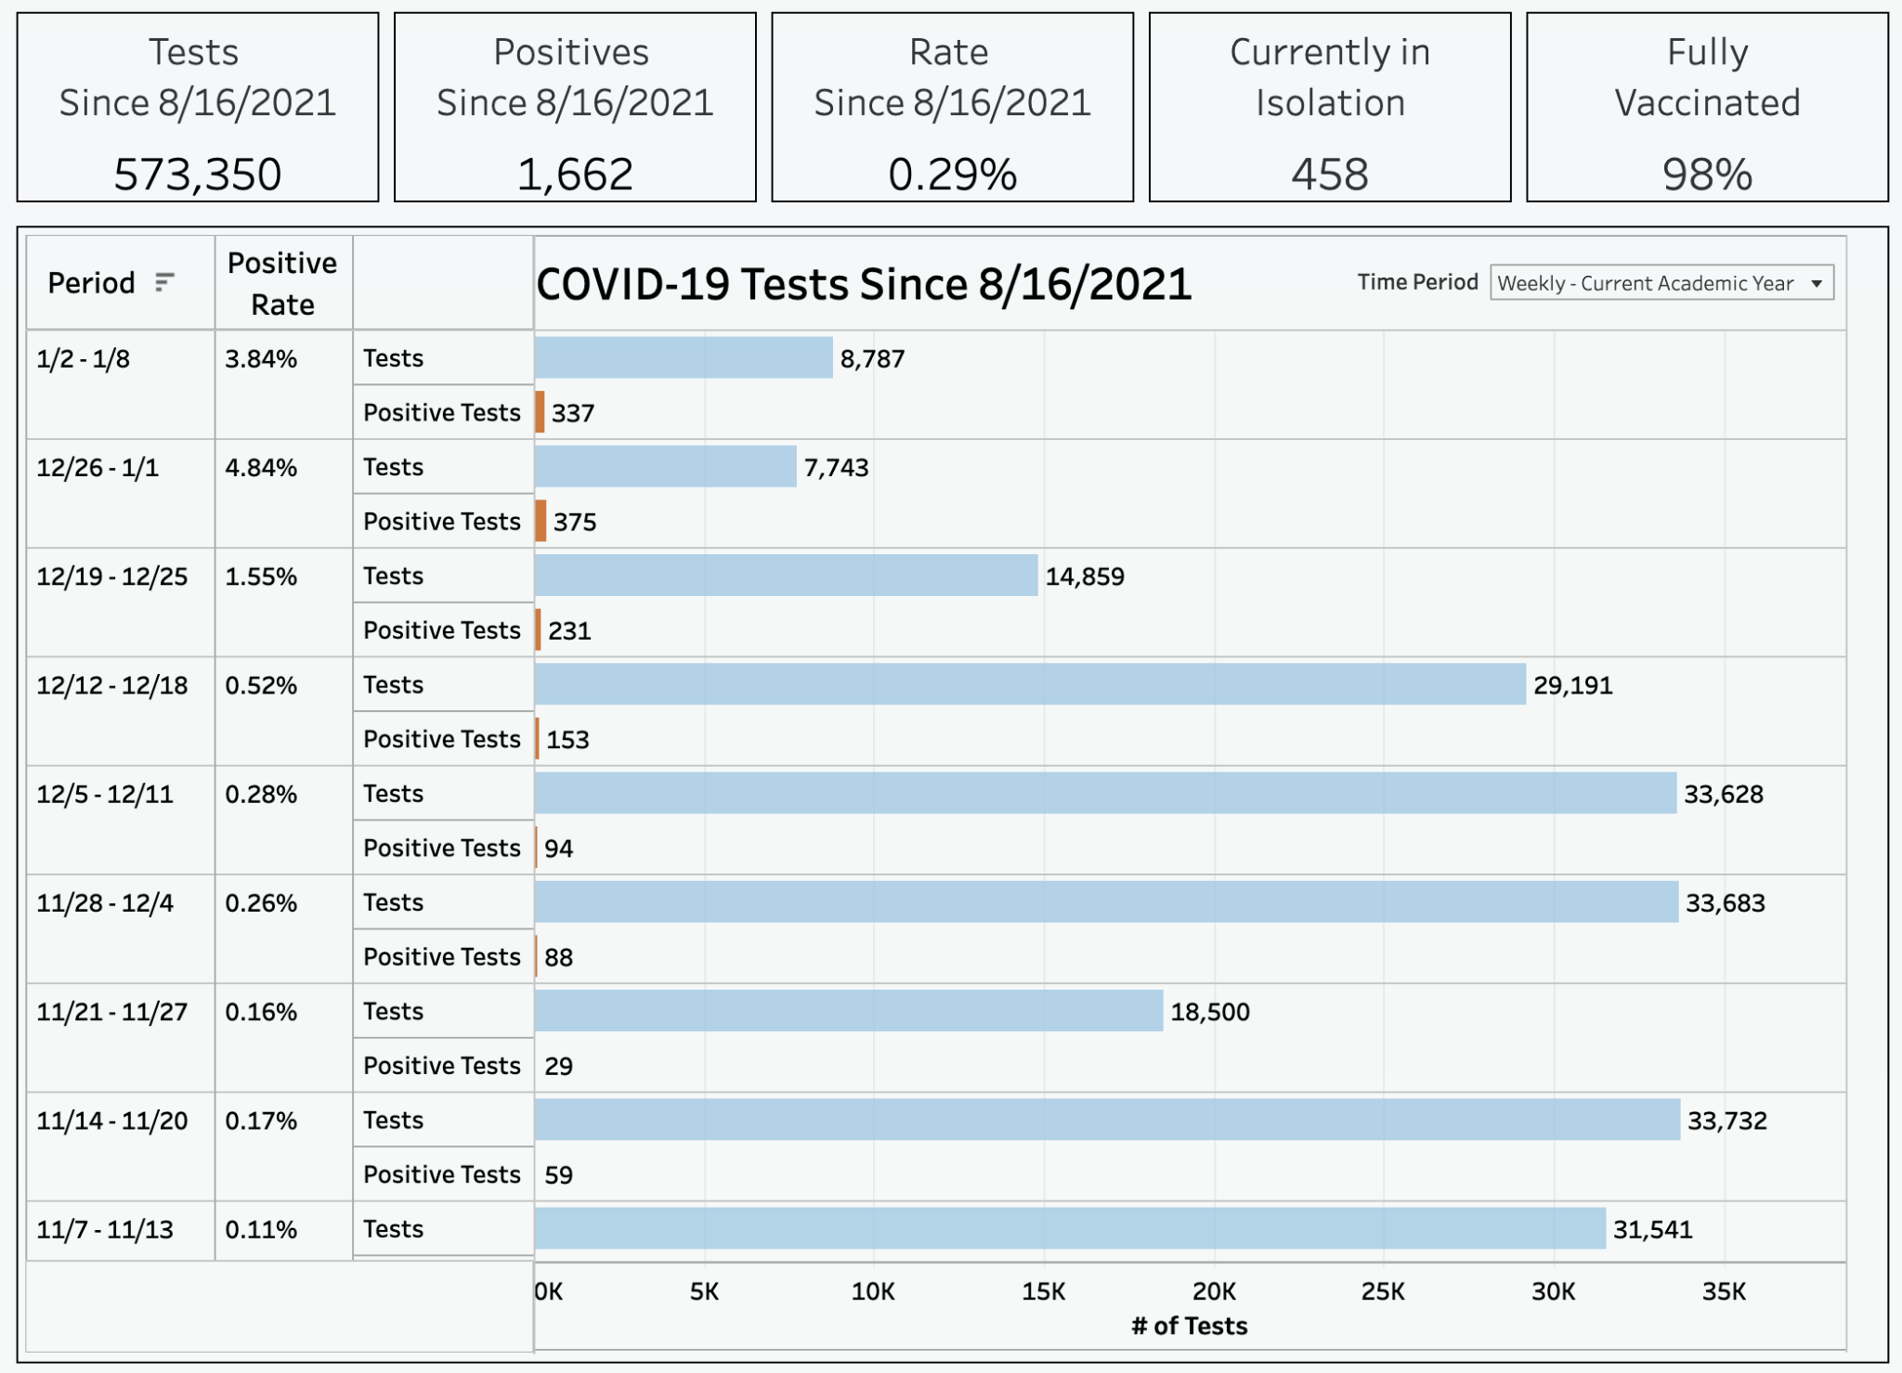
MIT case loads
one day of testing
Expecting > 1000 to test positive this week

Slide 5
Not apples-to-apples, but all in the same boat
Institution of higher ed | % positive, most recent 7-day stretch reported on dashboard, as of Jan 4 5pm ET
Harvard | 5.1%
BU | 4.7%
Tufts | 6.0%
Northeastern (Boston and other campuses) | 10.3%
Brandeis (Waltham) | 5.4%
Wellesley | 0.0% (2169 tests)
Boston College | 1.23% (week ending 12/19)
MIT | 3.7%

Slide 6
MIT cases / dashboard update
Numbers by the week
  12/12-12/18: 153 out of 29,191 tests (0.52%)
  12/19-12/25: 231 out of 14,859 tests (1.55%)
  12/26-01/01: 375 out of 7,743 tests (4.84%)
  01/02-01/08: 453 out of 11,734 tests (3.86%) and it’s only Wednesday morning!
Trends
  Widespread community transmission (few discernable patterns or clusters)
  Varying in demographics and areas of campus
  Cases mostly unknown route of exposure, but most seem to come from off-campus activities (many potentially from holiday gatherings)
  So far, symptoms continue to be mild for most individuals
  Concern right now: academic, research, and operational/business continuity
At these volumes, it is essential that individuals who test positive complete the Case Information Form without a call from MIT Medical.

Slide 7
IAP 2022 by the numbers
Looking at all students pre-registered, grad and undergrad…
~one-third of IAP subjects have transitioned significant components to remote for academic continuity
~2500 students are pre-registered for ~80 subjects that still have
a physical meeting place listed for IAP.
Campus density uncertain but growing…
3 out of 4 UG students were expected to be on campus the first week of IAP
Graduate student population is primarily local
However, so far, fewer than 1 in 2 students (G and UG) have tested or accessed campus.

Slide 8
Many students, faculty, staff will test positive
Our objective is ensuring academic and research continuity with many people in isolation for 5+ days
We have rapidly automated our processes to address the larger numbers of people testing positive (thank you IS&T team!)
Will continue to rely on vaccine + booster + masking as principal measures
  Booster deadline 1/14; as of today, ~65% have uploaded proof
  Multiple booster clinics planned every day next week: tinyurl.com/mitvaxclinic
Will continue testing to identify people who need to isolate, but contact tracing becomes less relevant with high levels of community spread
Opportunity to learn in preparation for an in-person spring semester

Slide 9
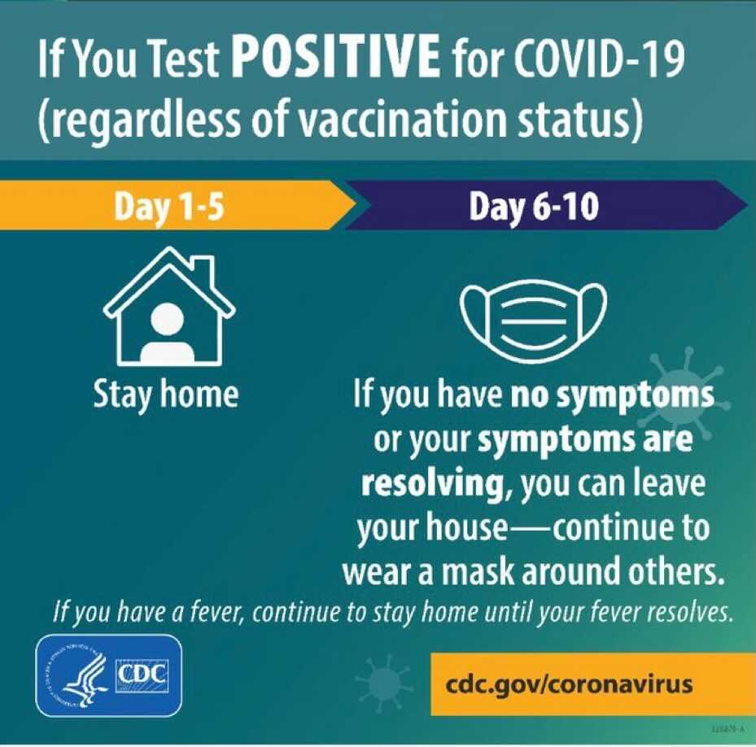
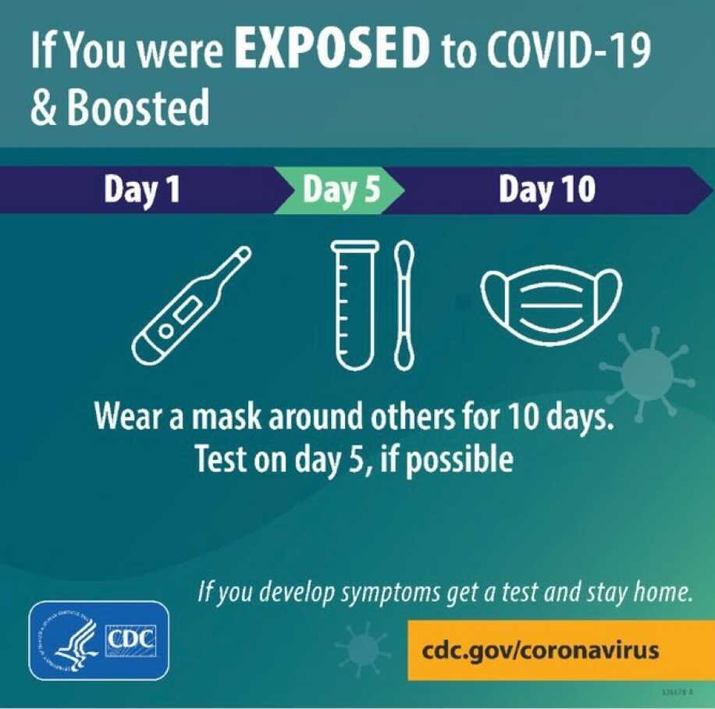
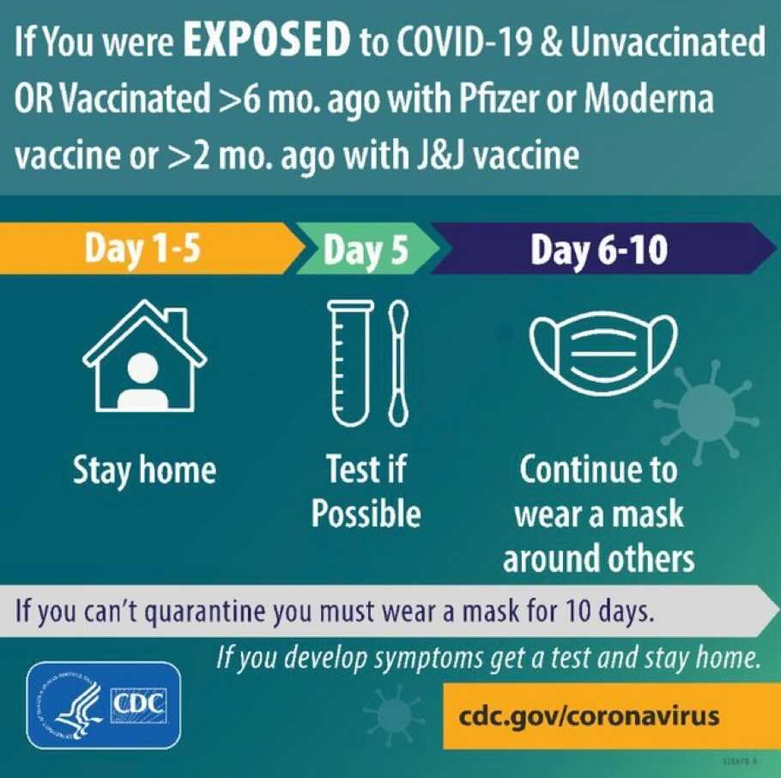
New CDC isolation guidelines
https://www.cdc.gov/media/releases/2021/s1227-isolation-quarantine-guidance.html
These came out on 12/27, were adopted by MA DPH on 12/29, and then put into practice at MIT on 12/30.

Slide 10
Key changes at MIT with Omicron
People who test positive get an automated email with instructions for isolation, and a Case Information Form to complete for MIT Medical which includes information about the person, close contacts, etc.
  MIT Medical will not follow-up with the individual or close contacts unless additional information is needed, or additional actions are required.
After 5 full days of isolating people will be automatically released from access restrictions (and moved to a 90-day testing hold as was our prior practice)
  If they have had a fever in last 24 hours or their symptoms are not mild or improving, they must continue to isolate until these conditions are met
  If they have questions or concerns they should contact MIT Medical or their provider

Slide 11
Key changes at MIT with Omicron
People who attest to symptoms will be advised to take a self-collected test and stay home until they get a positive or negative test result
We will not send de-identified notifications of positives to advisors, instructors, supervisors, administrators, etc. unless those individuals need to take a specific action.
  As necessary, individuals who test positive may contact their supervisors and/or HR managers (for employees), or advisors, instructors, and PIs (for students), as is true for other health-related absences.

Slide 12
Other operational elements
Isolation: Pivoting to isolate-in-place; food delivery to central locations for pick-up; and modified level of support for isolating students who do not need medical support
Masks: Pausing “one mask down at a time” policy; masks required for everyone always indoors; making KN95s and KF94s available across campus
Events: No food or drink at any MIT-hosted events on- or off-campus; grab-and-go or door drop treats by House team/GRA okay for small, residential study breaks
Eating indoors: De-densifying eating areas

Slide 13
Other operational elements
Visitors: Requiring visitors to attest to having the booster in Tim Tickets as of January 14
No policy changes for events (except no food/drink), visitors (except booster attestation), travel, or K-12. Access restrictions and attestation requirement will remain the same. Varsity athletic spectators Covid Pass holders only.

Slide 14
DSL Plan: Core elements
Policy
Test before arrival and bring personal isolation kits.
Quiet period for undergraduates pending two negative on-campus tests; may attend MIT-managed programs, classes, labs.
Well-fitted mask must be worn when outside of private room, suite, apartment or in an enclosed private space.
No changes to travel policies or to guest policy for House Teams, GRAs, and grads in residence.
No non-MIT overnight guests in UG Institute housing. Spectators to athletic events must be a COVID Pass holder.

Slide 15
DSL Plan: Core elements
Isolation
Isolate in place for five days. Automated messages, zoom/group meetings, may walk outdoors for 30 min. 2x daily, pick-up meals in designated locations of res hall, wear a well-fitted mask.
Floor restrooms designated for COVID-positive use, wearing well-fitted mask. Limit time showering and dry hair in room.
House Team/FSILG staff receive daily reports of students who need to isolate; reports also viewable securely online.
Rapid antigen tests used for roommates of student testing positive. If roommate is negative, they may stay in room, move to a campus space (if available), to home/suitable off-campus location, or to an emergency cot. If roommate tests positive, student to move back to room to complete isolation.

Slide 16
DSL Plan: Isolation & Food Service
FSILGs utilized DSL-supplied template to develop Covid plans for isolation, cleaning, and meal service.
Food Service
Isolation meals with four dietary options available at designated locations in UG houses, 70 Amherst, and Ashdown.
CFY to follow meal-prep guidance and eat in groups of four or fewer people.
Staff deployed to prepare meals for students.Some retail is open.
No food/drink at campus events. Grab-and-go food is okay at small house-sponsored events (e.g., floor study break).

Slide 17
Get boosted; wear a mask
The most important thing we can do right now to manage this is to stay masked, and get vaccinated and boosted.
MIT’s deadline for receiving a booster is January 14, 2022. This deadline also applies to those who are working or studying remotely.
On January 15th, access will be removed to campus and to testing for all who do not meet the requirement, plus we will put spring Registration holds in place for students (includes flu vaccine + booster compliance for students)
Currently, ~65% of the MIT community accessing campus has uploaded proof of a booster.
MIT Medical will hold additional clinics in January and at the beginning of the spring semester for those who are unable to find a booster appointment before then. (tinyurl.com/mitvaxclinic)

Slide 18
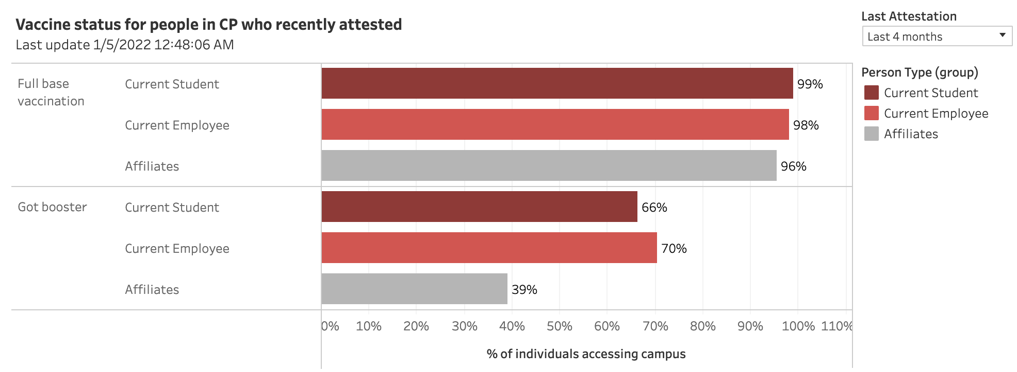
Vaccination status at MIT (1/5/22)

Slide 19
Spring semester (not there yet, but…)
We are planning for the spring term to be in person.
EVERYONE should have strong academic and research continuity plans in place for January and the first couple weeks of February.
It is essential that we learn and adapt now… before the spring term begins in February.
IAP provides that opportunity.

Slide 20
Discussion

