Slide 1
8AM Covid-19 Response Call
December 3, 2021

Slide 2
Agenda
Covid-19 update – Led by Ian A. Waitz, with the Covid-19 Testing Team, Emergency Management, Medical, Classroom Notifications and Support Team
Latest trends on campus post-Thanksgiving
Communicating positives (refreshers)
Academic continuity
Omicron variant
Boosters
Q&A – All

Slide 3
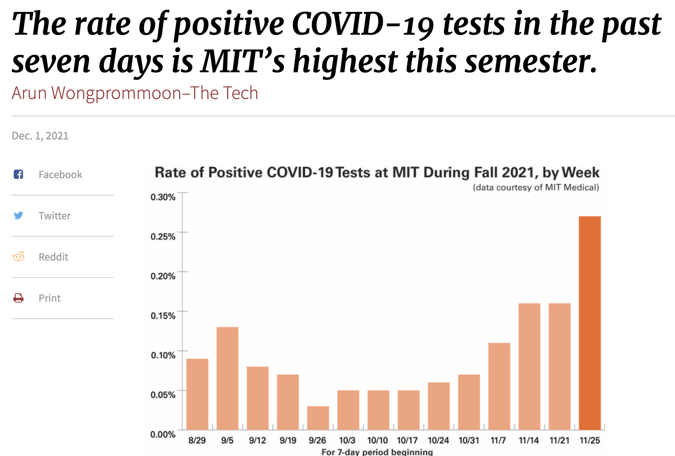
In one graph … expected, but concerning

Slide 4
Dashboard update and themes from cases
Expected post Thanksgiving increase
Overall case counts are increasing (0.27% positive rate)
Positives remain related to off-campus social interactions with food and drink, social interactions without masking, household contact of positive cases, recent travel, exposures to non-MIT positive cases off campus.
Still very limited on-campus transmission
Now more than ever, remain vigilant
Please continue to follow masking and tap-in requirements, and be courteous to others if they remind you to do the same.
We are at a critical time in the semester and want to maintain academic continuity as much as possible.

Slide 5
Attest, test, mask (repeat)
Testing 2x/week for students, 1x/week for staff
It’s (still) working.
Self-observed testing is easy and efficient.
Attesting is also working!
A number of positives caught from people reporting symptoms
The quickest way to get instructions/advice from MIT Medical
Off-ramp planning is still a priority
No significant changes expected until at least next semester.
Paying close attention to changing conditions.

Slide 6
Communicating positives (refresher)
Stop, breathe, hold internal communications.
If an instructor tests positive: Instructors should contact their department head, who will attempt to find an in-person replacement. The department should alert the Covid-19 Class Notification and Support Team, which will be available to assist with the department leadership.
If a student tests positive in a class setting: The Covid-19 Class Notification and Support Team will notify instructors. You can email questions to CovidClassHelp@mit.edu. See flow chart (next page).
If a staff member tests positive: DLC heads will be notified if a positive occurs in their org structure. If you hear the news before receiving this notification, you can contact your HR rep.
When in doubt about what to say (or if to say anything), contact Steve Bradt.

Slide 7
Notes:
What happens with a positive
Pulling class lists
Pulling Instructor lists
Identifying vaccination status of students

Slide 8
Academic continuity
Growing concern that some students are not reporting symptoms for fear that they might have to miss class, especially, this late in the semester and with finals looming.
UA Survey (~1000 responses, key concern = lack of support for missing classes)
Some of those classes have resources available
Instructors please communicate how students who must miss class will be supported
Please reach out for help and resources (https://tll.mit.edu/teaching-resources/fall-2021-teaching-resources/)
The Chair of the Faculty has also been in contact with departments and instructors
There is a parallel concern of some community members not taking minor symptoms seriously. Ignoring symptoms (esp. if they turn out to be Covid) can put many others at risk.

Slide 9
Omicron
What we know…
On 11/26/2021, WHO declared SARS-CoV-2 variant B.1.1.529 as a Variant of Concern (VOC), now designated as Omicron
Reported to WHO by South Africa on 11/24, after noting a steep rise in cases coincident with the detection of B.1.1.529 variant
As of today, Omicron has been detected in 24 countries including the United States; in South Africa it represents 73% of the cases (source: GISAID)
B.1.1.529 has 32 mutations on the spike protein alone. For comparison, Delta had 9 changes on the spike protein. B.1.1.529 does not have previous Delta “ancestors” and likely mutated over time in one, likely immunocompromised, individual
These mutations likely result in increased transmissibility
What we don’t know…
Does Omicron cause more or less severe disease?
We should know more in 2-3 weeks

Slide 10
Omicron (continued)
Does this change what we are doing?
Not really. Our requirements and policies position us well for Omicron.
We should continue to be cautious in our interactions and continue to wear masks.
Everyone who is eligible should get a booster as soon as possible.

Slide 11
Boosters
CDC Update / Recommendation
As of this week, the CDC is advising that all individuals 18 and older SHOULD get a COVID-19 booster vaccine.
MIT Position (letter to the community from Cecilia Stuopis)
MIT has not yet determined whether it will require booster vaccines for students and employees.
For community members engaging in MIT-sponsored travel, MIT will require COVID-19 booster vaccines beginning on December 17.
MIT Medical is offering appointments for boosters (now sold out; 2600 in 3 hours!); looking to add more.

Slide 12
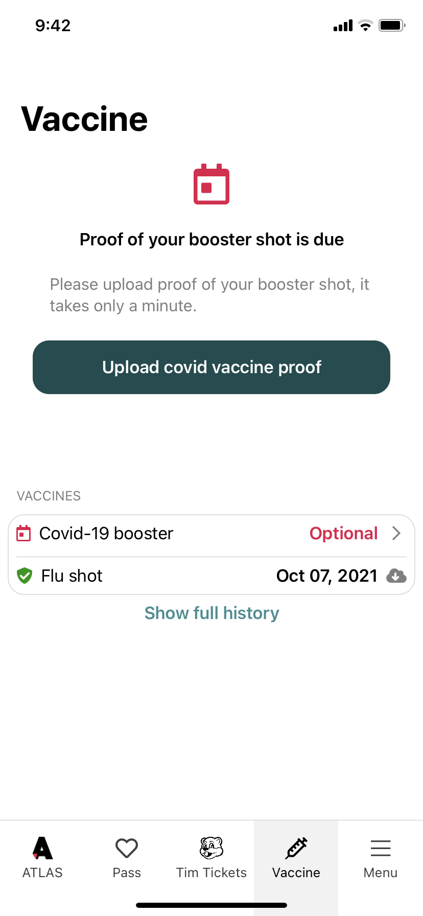
Boosters
Covid Pass / Vaccine
Upload function now available for Boosters

Slide 13
Thoughts on what’s next (redux)
We are watching conditions carefully
There are three (unsurprising) scenarios for the coming months:
things get worse (winter wave): Keep our current policies.
things stay the same: Keep our current policies.
things get better: We start to relax our current policies.

Slide 14
Closing comments
Good news: we’ve made it to December with almost all aspects of our mission enabled!
Even with the expected Thanksgiving increase, cases have been relatively low all semester.
There’s been no need to move to remote teaching & learning.
Community members have been flexible and adaptable—but, understandably, we would all like this to end (and we are hoping and planning for that)....
We will continue to get through this together.

Slide 15
Q&A

